Slide 1
General Guidelines for Presentation
General Guidelines for writing PPT and project Report: Both should have same content. Report being the detailed explanation of the PPT points that you explain orally while presenting.
PPT :
The content should be only the important points in the form of bullet list with meaningful short sentences and phrases. Running texts and big paragraphs are not accepted.
It should have proper citations.
Diagrams should be original and should be visible clearly.
Use minimum font size of 17
Put mathematical models and algorithms / methods explanations where ever necessary.
Emphasize on your original thinking, original work and contribution and highlight them in the slide.
Project Report:
The PPT content and the project report content should match.
All the points of PPT should be well explained and where needed they should be justified by using citations and /or by proper analysis and proofs.
Emphasize on your original thinking, original work and contribution and highlight them in the appropriate places in the report.
The diagrams / figures and tables should be numbered and tilted and should be refereed in the text with their numbers mentioning the purpose of the same. Also explain them in your own words w.r.t. the purpose, the contents, relation of various entities in them, etc.
All references should be used as citations at the appropriate places.
The following chapter slides will give general information of the points to be considered and the sequence in which they need to be explained to give a proper flow to the report and to the presentation.
Nevertheless, you are free to modify, add or delete few points as per your problem needs.
Notes:
1

Slide 2

Android based Carpooling Application
Manasi Patil (22106042)
Ikra Sayyad (23206006)
Pratiksha Pathak (22106127)
Project Guide
Prof. Bharti Khemani.
Notes:
2

Slide 3
Outline
Introduction
Literature Survey of the Existing Systems
Limitations of the Existing Systems
Problem Statement
Proposed System Design
Technologies Stack for Proposed System
Implementation(Partial)
Conclusion
References
Notes:
3

Slide 4
Introduction
An open-source carpooling application for Android devices.
Ride matching, real-time tracking, secure payments, and user verification.
Ensuring trust, safety, availability of rides, and legal compliance.
Reduces travel expenses, minimizes carbon footprint, saves time, and promotes social connections.
The app enables users to share rides with others traveling in the same direction, reducing commute costs, carbon footprint, and traffic congestion.
Notes:
4

Slide 5
Trip Creation: Users can create and schedule rides based on time, date, and route.
Security Features: Includes user verification, driver background checks, GPS tracking, SOS button, and ride-sharing safety.
Ratings System: Drivers and passengers rate each other for trust and safety.
Trip History: View past rides, with options to save recurring trips.
Payment Integration: Cashless payments with fare calculations and splitting options.
Notifications: Real-time trip updates, reminders, and status alerts.
Carpool Groups: Create or join groups for regular rides.

Slide 6
Motivation: The increasing traffic congestion, rising fuel costs, and environmental concerns highlight the need for an efficient carpooling solution.
A carpooling application promotes ride-sharing, reducing expenses, carbon emissions, and travel time while enhancing social connectivity. Optimizing vehicle usage provides a cost-effective and eco-friendly commuting alternative.
Objectives: Reduce carbon emissions and fuel consumption for a sustainable environment.
Enable users to split fuel and toll expenses, making travel more affordable.
Allow users to book, schedule, or find instant rides based on availability and Foster a community-driven approach to commuting by connecting people traveling in the same direction.

Slide 7
Literature Survey of the existing system
Research Paper | Summary | Adaptation
GoToUni | A university-specific carpooling app that aims to reduce parking issues and commuting costs for students and faculty members by facilitating carpooling. | Could be expanded to cover additional institutions or integrate with university transportation systems to reduce congestion.
Traveling Buddy | An Indian carpooling app that focuses on ID verification and allows users to post and join trips, particularly targeting non-car owners | Adapt for other regions or enhance features like real-time tracking and in-app payment systems to increase user trust.
Android App Development: A Review | The research paper "Android App Development: A Review" explores using Android App Inventor 2 to create a user-friendly library management app, allowing easy access to library resources via smartphones. | The findings can be applied to develop similar applications for educational institutions, enhancing access to library resources and improving user engagement
Blockchain Carpooling | A decentralized, blockchain-based ride-sharing system using smart contracts to ensure secure transactions and accountability among users. | Could be adapted to integrate with existing carpooling apps or used as a platform for eco-friendly car-sharing services.
Smart Carpooling Survey | A study that uses GPS data to track ride-sharing, focusing on cost savings and environmental sustainability. | The survey's findings can be used to develop a real-time route optimization feature for carpooling apps, encouraging greener travel.

Slide 8
Limitations of Existing Systems
Trust and Safety Issues
Inconsistent Availability
Pricing and Cost Transparency
Poor User Experience
Limited Customization and Flexibility
Lack of Incentives for Drivers
Notes:
8

Slide 9
Problem statement
Traffic congestion, high fuel costs, environmental pollution, overcrowded public transport, parking shortages, and safety concerns have made daily commuting difficult, especially for students and professionals. To address these challenges, our Android-based carpooling app offers a convenient and affordable ride-sharing solution. The app allows users to offer or join rides, reducing traffic and travel expenses while promoting an eco-friendly approach. Features like verified profiles, ride ratings, document verification, live tracking, and trip history enhance security and convenience. By integrating these functionalities, the app provides a sustainable and efficient alternative to modern commuting issues

Slide 10
.
Proposed System Design
Notes:
10

Slide 11
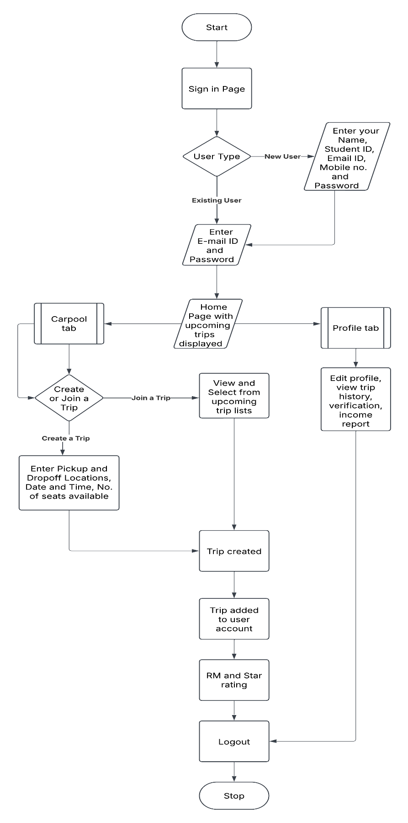
Block Diagram of Carpooling App

Slide 12
Technology Stack for Proposed System
Android Studio: Kotlin-based App
• Firebase: Firebase Database is the Realtime Database based on your specific requirements. Firebase is NoSQL database, and they provide real-time data synchronization.
• Figma: Design the user interface (UI) using Figma. Figma is a collaborative design tool that allows for real-time collaboration and prototyping.
• Git: Use Git for version control to track changes, collaborate with a team, and manage the source code of your application.
Firebase Authentication: User sign-in/signupSecure, easy to integrate Firebase Realtime Database Store user/ride details real-time sync, prevents crashes Google Play Services Maps & location tracking Real-time GPS
Notes:
12

Slide 13
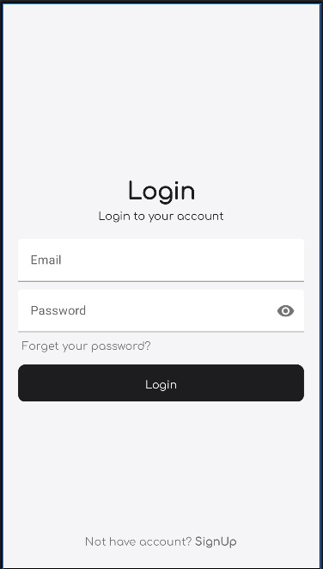
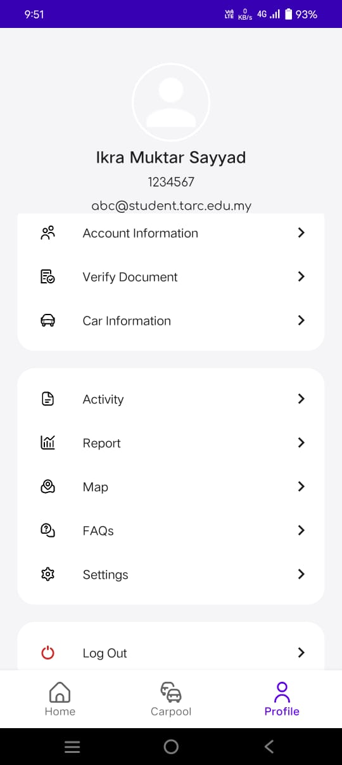
LOGIN AND PROFILE PAGE
Implementation
Notes:
13

Slide 14
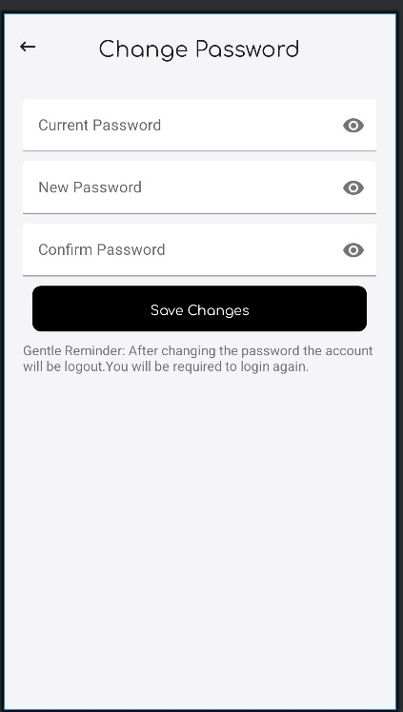
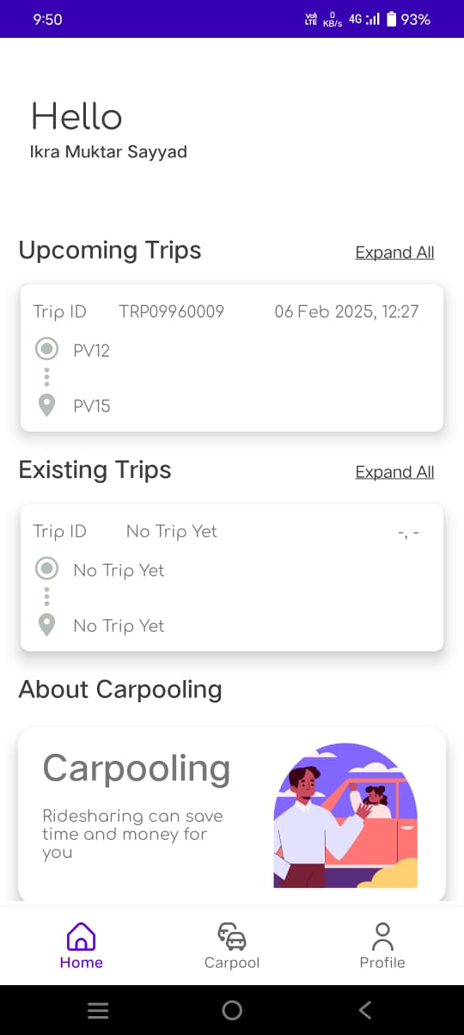
PASSWORD AND HOMEPAGE

Slide 15
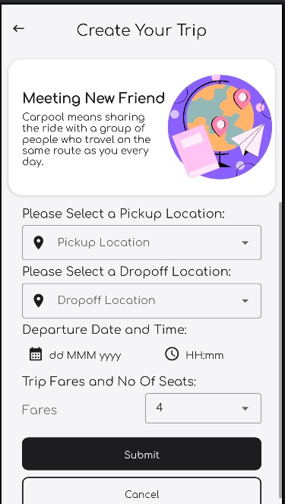
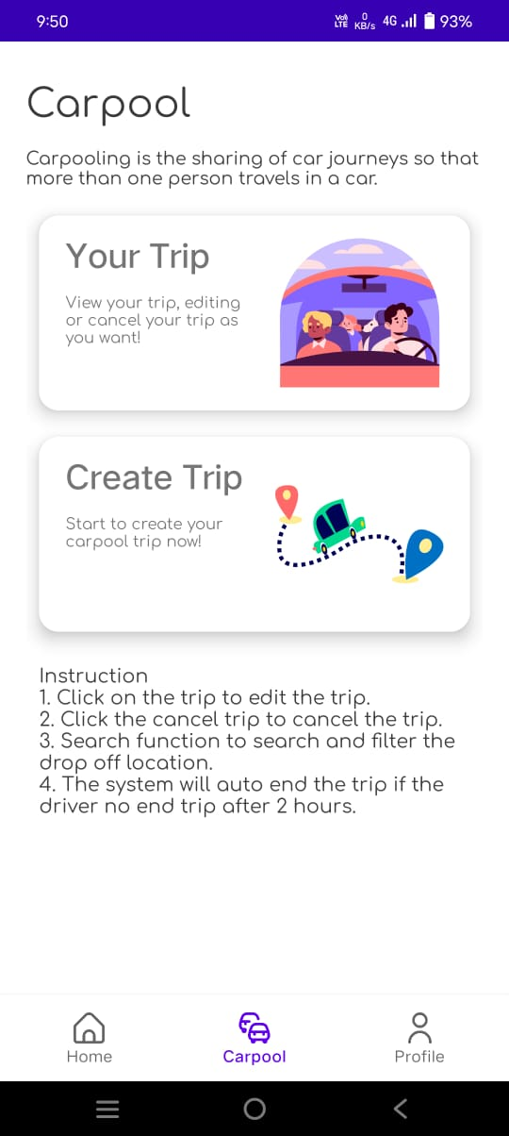
CREATE YOUR TRIP

Slide 16
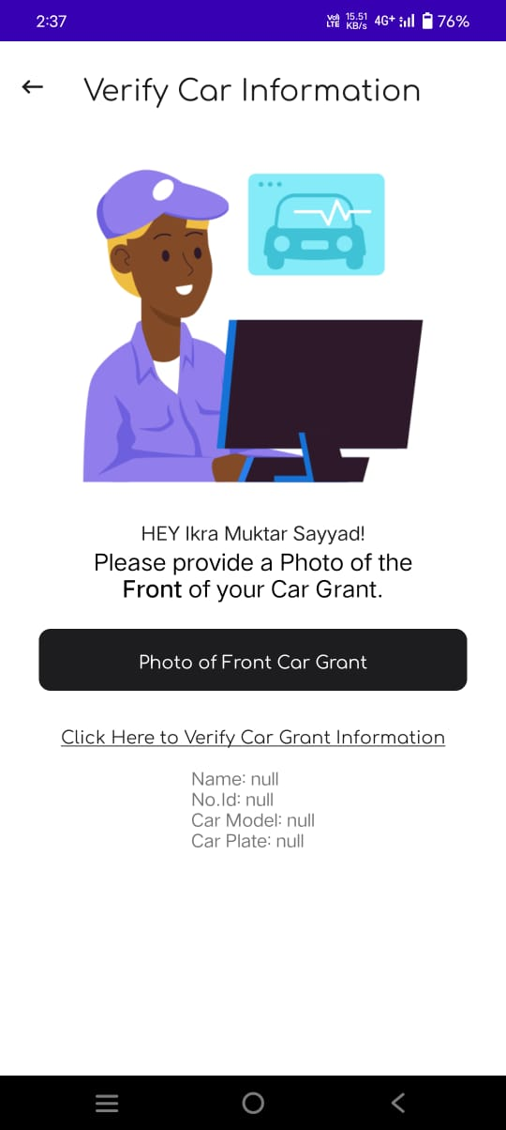
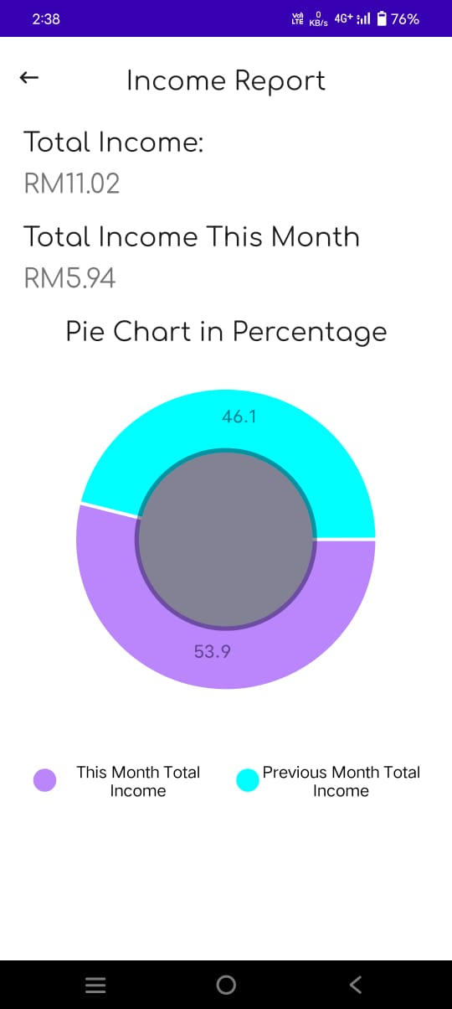
VERIFICATION AND BOOKING THE CAR

Slide 17
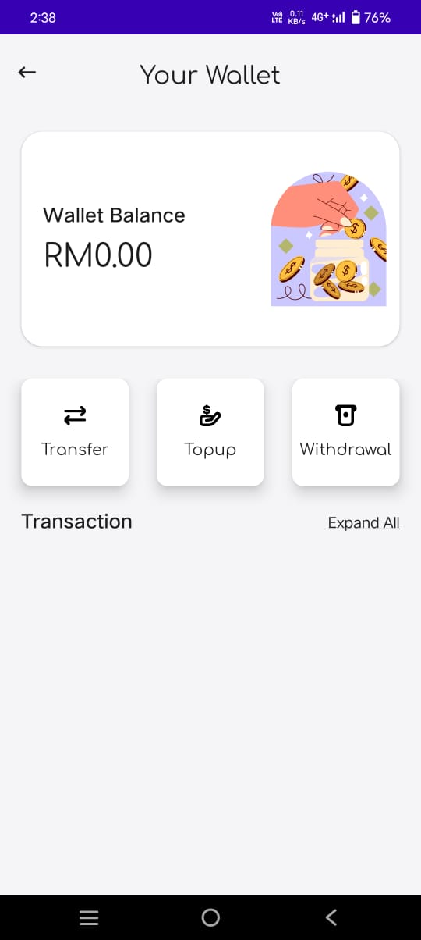
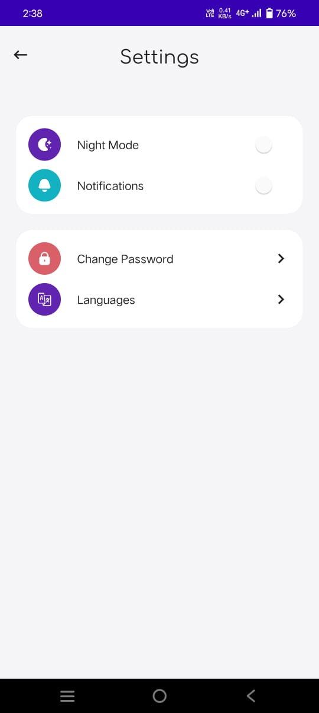
PAYMENT AND LOGOUT

Slide 18
Applications
Daily Commuting.
Corporate Carpooling
Long-Distance Travel.
Event Transportation
Eco-Friendly Mobility .
Emergency Ride Sharing
Community-Base Carpooling.
Student & University Carpooling

Slide 19
Conclusion
Demonstrates technology's role in solving student transportation challenges.
Offers a scalable framework for wider institutional use.
Promotes cost savings, sustainability, and social connections.
Highlights the impact of open-source solutions on real-world problems.
Notes:
19

Slide 20
References
Real-time carpooling and ride-sharing: Position paper on design concepts, distribution and cloud computing strategies. “Dejan Dimitrijević, Vladimir Dimitrieski, and Aleksandar M. Milinković.”
On Design of a Dynamic Carpooling System Based on Vehicle Information Shared Through the VANET. “Ing-Chau Chang, Ssu-Ni Hung, and Chin-En Yen”.
Design of Blockchain and Smart Contract Enabled Ride Sharing System. “Shuchih Ernest Chang”
Dynamic Carpooling Application for Better Environment. “S. Naga Jyothi, T. Haveela, T. Geeshpa, R. Swapna, and T. Sumallika”.
Smart Peer Car Pooling System. “Raza Hasan, Haftamu Menker Gebreyohannes, Abdul Hadi Bhatti, Mohammad Sohail Hayat, and Abeer Javed Syed”.
Notes:
20

Slide 21
Thank You...!!
Notes:
21

